Slide 1
HTML5 – New Features

Slide 2

Objectives
To Understand:
  New Features in HTML5
    What is HTML5?
    HTML5 Features
    Semantic/ Structural Features
    HTML5 Forms
      New Form Elements and Attributes
    HTML5 Media
      Audio/Video Support
    HTML5 Graphics
      Canvas
      SVG
    HTML5 API
      Drag and Drop
      Web Storage
      Web Workers
      Geo Location

Slide 3

HTML 5 – New Features
What is HTML5?
  HTML5 is a spec in making web pages
  Started at WHATWG – Web Hypertext Application Technology Working Group.
  HTML5 is a suite of tools for:
    Markup (HTML 5)
    Presentation (CSS 3)
    Interaction (DOM, Ajax, APIs)
HTML5 ≈ HTML5+CSS3 +JavaScript

Slide 4



HTML 5 – New Features
What is WHATWG ?
  Web Hypertext Application Technology Working Group
  Founded by individuals from Apple, the Mozilla Foundation and Opera Software
  Community interested in evolving HTML and related technologies
?

Slide 5
Why HTML 5
Search Engine Optimization
Local Storage and cache
Game Development
Cross Browser Support
Improved Semantics and Cleaner Code
Inbuilt Multimedia Support
Interactive
Better data entry and form fields
Simple Doctype
Remote Updates
Hybrid Apps
Accessibility (Semantics and ARIA)
Mobile

Slide 6

HTML 5 – New Features
What’s New?
  Semantic Elements
  Form Elements
  Graphic Elements
  Audio and Video Support
  Web Workers
  Web Storage
  Geolocation

Slide 7
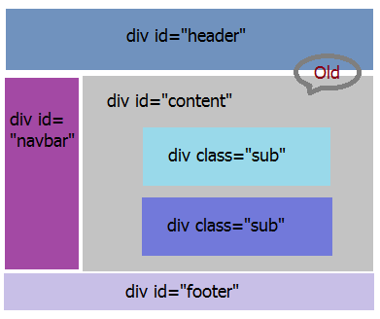
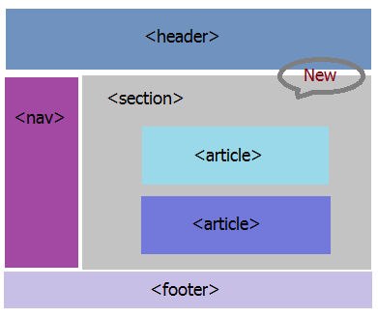
HTML 5 – New Features
Semantic Elements
  New Elements to define the structure of the web page
HTML4
HTML5

Slide 8
HTML 5 – New Features
Semantic Elements
  Some of the new Elements are:
    Header:
      Specifies a header for a document or section.
    Nav
      Represents a major navigation block. It groups links to other pages or to parts of the current page.
    Footer
      Defines a footer for a document or section
    Article
      Defines an article
    Aside:
      The "aside" element is a section that somehow related to main content, but it can be separate from that content
    Section
      Defines a section in a document

Slide 9


HTML 5 – New Features
Semantic Elements
  Some of the new Elements are:
    Progress:
    Meter:
created to indicate progress of a specific task
To be used when the minimum value and maximum value are clearly defined.

Slide 10


HTML 5 – New Features
HTML Forms
  New Input Types
    Date, color, url, email, tel, range,etc…
    These new features allow better input control
    and validation
  New Form Elements
  New Attributes
  New Events
Not all major browsers support all the new form elements.
If they are not supported, they will behave as regular text fields.

Slide 11

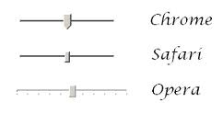
HTML 5 – New Features
HTML Forms
  Input Types:
    Number:
      creates a field intended for numerical input.
    Range:
      creates a slider that allows the user to select a numeric value.
On iOS, tapping the field displays a numeric keypad, but you can also switch to alphabetic input.
This is intended to be used when the exact value is not important.

Slide 12
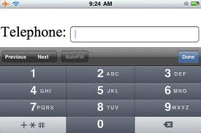
HTML 5 – New Features
HTML Forms
  Input Types:
    Tel:
      Input fields that accept phone numbers use the "tel" type.
      Due to inherent variances in phone number formats, it does not conform to any specific pattern.
      By Default No attempt is made by the browser to validate the field. Validation against a pattern can be done using the “pattern” attribute.
Mainly used to optimize the keyboard on mobile devices.

Slide 13
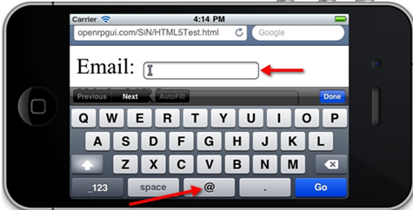
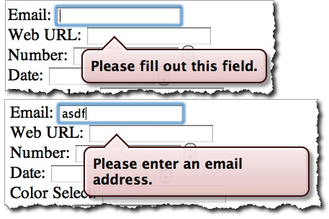
HTML 5 – New Features
HTML Forms
  Input Types:
    email:
      a control for editing a list of e-mail addresses given in the element’s value.
      Help in entering a valid email address.
      When the user submits the form, the browser automatically performs RFC-compliant email validation, whether JavaScript is enabled or not, and displays a generic message
One nice treatment is seen on smart phones, the keyboard associated with this field elevates the "@" and "." key buttons to the same level as the space bar.

Slide 14
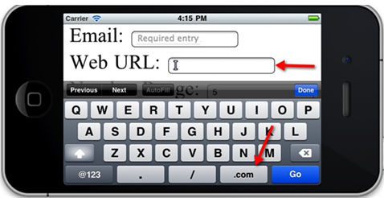
HTML 5 – New Features
HTML Forms
  Input Types:
    URL:
      A control for editing a list of e-mail addresses given in the element’s value.
      Help in entering a valid email address.
In the case of the url it adds a ".com" button

Slide 15
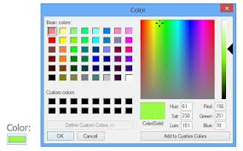
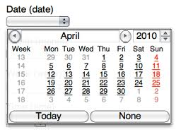
HTML 5 – New Features
HTML Forms
  Input Types:
    Color:
      For choosing color through a color well control.
    Date:
Allows the user to select a color and returns the hex value for that color.
These date pickers aren’t restricted to desktop devices; some Blackberry devices and Chrome for Android render its internal date

Slide 16
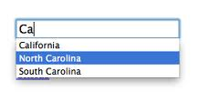
HTML 5 – New Features
HTML Forms
  Input Types:
    Datalist:
      Allows to present the user with a range of options to use in a text input box, as well as being able to type in their own.
      Simply use the list attribute to connect an ordinary input to a list of options
This is best used when there aren’t too many options, because with no filter applied to the list as you type it doesn’t get any shorter the more characters you input.

Slide 17
HTML 5 – New Features
HTML Forms
  Form Attributes:
    A series of new attributes for form controls are:
      placeholder
      autofocus
      autocomplete
      required
      Pattern
      novalidate ,formnovalidate
      form
      formaction
      formenctype
      formmethod
      formtarget

Slide 18

HTML 5 – New Features
HTML Forms
  Form Attributes:
    placeholder:
      Used to display hints inside text fields, usually in light gray.
      When the field has focus, the hint disappears.
<script src="Placeholder.js"/>
<p>New way: <input type="text" placeholder="Type here..."/></p>
<p>Old way: <input type="text" value="Type here..." style="color:#aaa" onfocus="this.value='‘; "/></p> <script>Placeholders.init();
</script>

Slide 19

HTML 5 – New Features
HTML Forms
  Form Attributes:
    autofocus:
      Used to have a form field automatically focused when a page is loaded.
      you shouldn't have more than one autofocus form control on a single page.
    autocomplete:
      helps users complete forms based on earlier input.
      The default state is set to on. This means that generally we won’t have to use it..
      To set it off use as :
<input type="text" name="name" id="name" autofocus>
<input type="text" name="name" id="name" autofocus autocomplete=“off”>

Slide 20
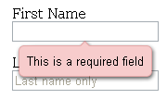
HTML 5 – New Features
HTML Forms
  Form Attributes:
    required:
      The browser requires the user to enter data into that field before submitting the form.
      Replaces the basic form validation currently implemented with JavaScript.
    pattern:
      specifies a JavaScript regular expression for the field’s value to be checked against
      makes it easy for us to implement specific validation for product codes, invoice numbers, and so on.
<input type="text" id="given-name" name="given-name" required>
<input type="text" … pattern="[a-z]{3}[0-9]{3}">

Slide 21
HTML 5 – New Features
HTML Forms
  Form Attributes:
    Novalidate and formnovalidate:
      Indicate that the form shouldn’t be validated when submitted
        formnovalidate can be applied to submit or image input types.
        The novalidate attribute can be set only on the form element
<form action=“login">
<label for="email">Email:</label>
<input type="text" name="email" value="go@example.com">
<input type="submit" formnovalidate value="Submit">
</form>
<form action=“login“ novalidate>
<label for="email">Email:</label>
<input type="text" name="email" value="go@example.com">
<input type="submit“ value="Submit">
</form>

Slide 22
HTML 5 – New Features
HTML Forms
  Form Attributes:
    form:
      used to associate an input, select, or textarea element with a form
      It means that the element doesn’t need to be a child of the associated form and can be moved away from it in the source.
    formaction, formenctype, formmethod, and formtarget
      formaction:
        Specifies the file or application that will submit the form.
        Has the same effect as the action attribute on the form element and can only be used with a submit or image button
      formenctype:
        Details of how the form data is encoded with the POST method type.
<input type="button" name="sort-l-h" form="sort">
<input type="submit" value="Submit" formaction="process.php">

Slide 23

HTML 5 – New Features
HTML Forms
  Form Attributes:
      formmethod:
        Specifies which HTTP method (GET, POST, PUT, DELETE) will be used to submit the form data.
      formtarget:
        Specifies the target window for the form results, submit or image button
    formaction, formenctype, formmethod, formtarget
      These new attributes have been introduced primarily because you may require alternative actions for different submit buttons, as opposed to having several forms in a document.

Slide 24

HTML 5 – New Features
Audio and Video:
  Built-in media support via the <audio> and <video> elements, offering the ability to easily embed media into HTML documents.
  A flash fallback could be provided for browsers that don't support HTML5 media
  Most commonly used formats :
    Audio: ogg, mp3 and wav
    Video: Ogg, mpeg4
<video src="movie.ogg“ id="video">...</video>
<button onclick="video.play();"> Play </button>
      Media playback can be controlled via JS and media events

Slide 25

HTML 5 – New Features
Audio and Video(Contd..):
  Pros
    Greater compatibility
    Better performance
    simple browser coding makes HTML5 videos more searchable and indexable
It will be possible to serve and play back hardware-accelerated video in the browser, on a smartphone or tablet, or in an embedded device, all without having to do lots of special coding.

Slide 26
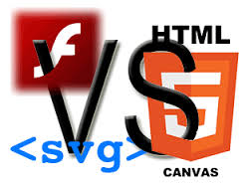
HTML 5 – New Features
Canvas and SVG
Canvas:
  <canvas> element is used to draw graphic
  Canvas is a container on which graphics is drawn
  by using javascript
SVG:
  SVG stands for Scalable Vector Graphics which is used to draw graphics on the web.
  <svg> element is a container for SVG graphics.
  SVG has several methods for drawing boxes, circles, text, and graphic images

Slide 27
HTML 5 – New Features
Difference between Canvas and SVG
Canvas | SVG
Resolution dependent | Resolution independent
2D graphics with javascript | 2D graphics in XML
No support for event handlers | Support for event handlers
Poor text rendering capabilities | Best suited for applications with large rendering areas
Well suited for graphic-intensive games | Not suited for game applications
Raster based (composed of pixel) | Vector based (composed of shapes)
Modified through script only | Modified through script and CSS
Single HTML element similar to <img> in behavior | Multiple graphical elements, which become the part of the DOM

Slide 28

HTML 5 – New Features
Web Storage
  Web pages can store data locally within the
  user's browser.
  Is more secure and faster.
  The data is not included with every server
  request, but used ONLY when asked for.
  Possible to store large amounts of data, without affecting the website's performance.
  Storage items are available on the entire domain.
  Two categories of Storage:
    Local Storage - stores data with no expiration date
    Session Storage - stores data for one session.
  Data saved as key/value pairs.

Slide 29
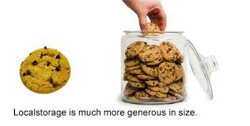
HTML 5 – New Features
Web Storage
    Local Storage:
      Local Storage provides a persistent data store of up to 5MB.Each browser will have its own, individual 5MB store.
      Secure as data is not shared between browsers.
      Is available through the localStorage object

Slide 30

HTML 5 – New Features
Web Storage
    Session Storage:
      Stores the data for only one session.
      The data is deleted when the user closes the browser window.
      Session Storage, we have a separate data store for each window or tab that’s open.
      Is available through the sessionStorage object
      Session Storage solves a problem that’s plagued with cookies:
      Assume that you’re shopping for plane tickets online, and you have multiple windows open to try and find the best deal. Even though you have multiple windows open, if the site is using cookies to track your orders, the cookies are all shared across the multiple windows. This could result in accidentally purchasing the same ticket twice.

Slide 31

Test your Memory…
Can localStorage replace Cookies?
No, Cookies and local storage really serve difference purposes. Cookies are primarily for reading server-side, local storage can only be read client-side.
So depending upon the needs:
If it's your client (your JavaScript), then by all means switch. You're wasting bandwidth by sending all the data in each HTTP header.
If it's your server, local storage isn't so useful because you'd have to forward the data along somehow (with Ajax or hidden form fields or something). This might be okay if the server only needs a small subset of the total data for each request.
Notes:
Apache Struts Lecture 1: Intro

Slide 32

HTML 5 – New Features
Web Workers:
  Defines an API for spawning background scripts
  Allows to fire up long-running scripts to handle computationally intensive tasks, but without blocking the UI or other scripts to handle user interactions.
  Web Workers run in an isolated thread. As a result, the code that they execute needs to be contained in a separate file
      Making JavaScript multi-threaded would require a lot of architectural changes, so Web Workers offers a way around this, enabling the language to be extended so that it can appear to be multi-threaded in certain cases.

Slide 33

HTML 5 – New Features
Drag and Drop:
  Powerful User Interface concept
  Provides the ability to natively drag, drop, and transfer data to HTML elements.
  Drag and Drop (DnD) API provides the support
<div id="boxA" draggable="true" ondragstart="returnragStart(event)">
dragstart
dragenter
dragover
dragleave
drag
drop
dragend
      To drag an element, you need to set the draggable attribute to true for that element.

Slide 34

HTML 5 – New Features
Geolocation:
  Geolocation API is used to get the geographical position of a user.
  Since this can compromise privacy, the position is not available unless the user approves it
  getCurrentPosition() - method is used to return the user's position.
  watchPosition() - Returns the current position of the user and continues to return updated position as the user moves (like the GPS in a car).
  clearWatch() - Stops the watchPosition() method
Geolocation is most accurate for devices with GPS, like iPhone

Slide 35

References
Websites:
  HTML5Demos.com
  Html5rocks.com
  Netmagazine.com
Books:
  Pro HTML5 Programming
  Dive into HTML5
  Beginning HTML5 and CSS3: Next Generation Web Standards
Notes:
Apache Struts Lecture 1: Intro

